Slide 1

P146: Dog Monitoring System
Team Members
Deba O. Imade, Nicolae D. Lesenco, Clayton M. Lucas
Sponsor: Dr. Greg Turner

Slide 2
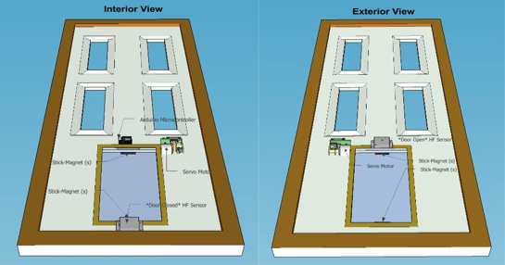
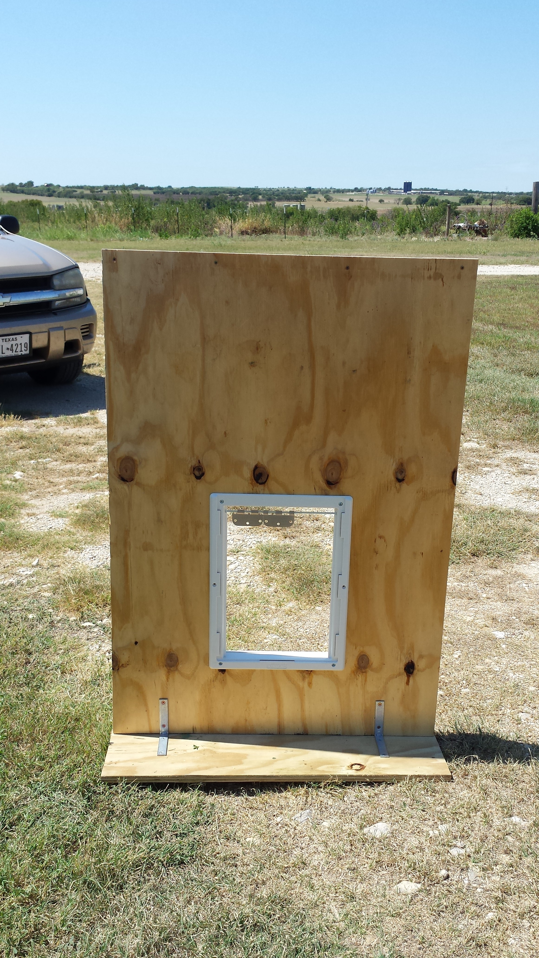
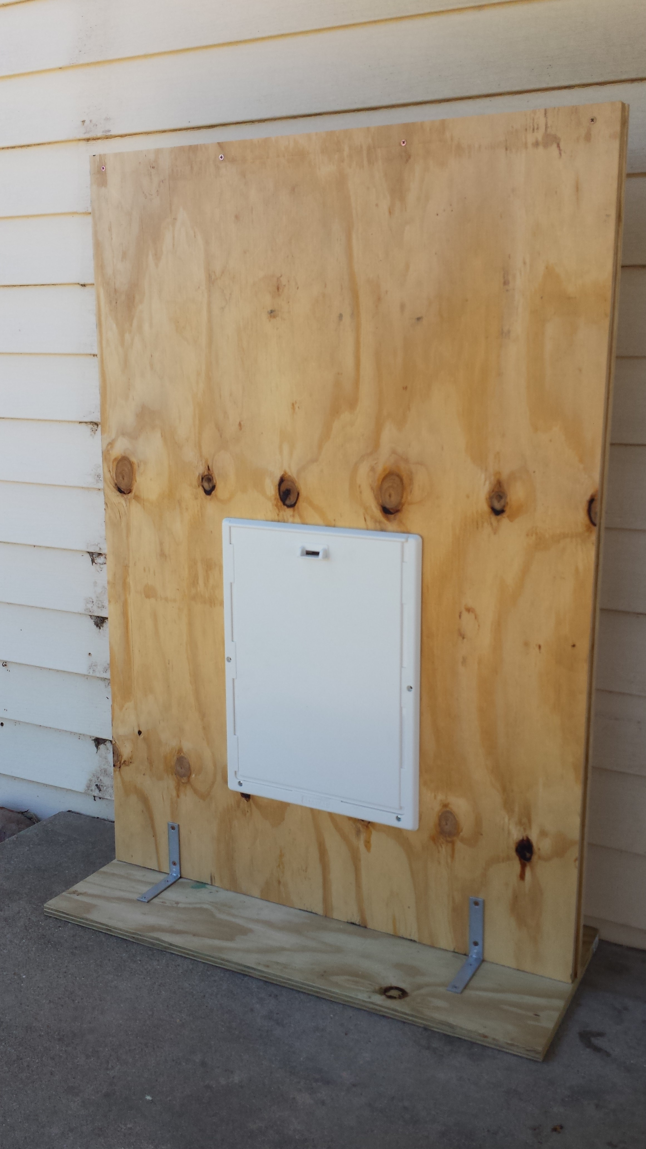
Door Assembly

Slide 3
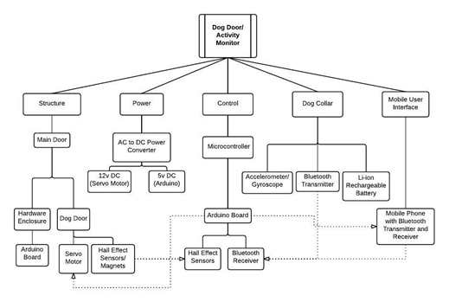
Design Description

Slide 4
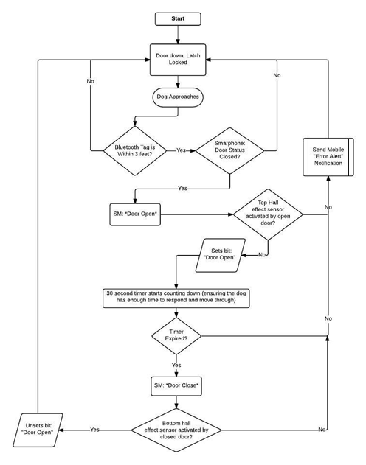
Program Flow

Slide 5
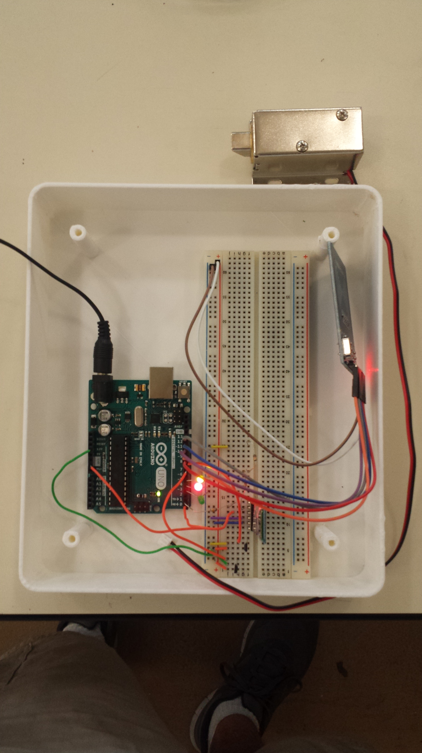
Control
Solenoid plunger
RFID Module
LED Indicators
Bluetooth Module
Hall Effect Sensors
-HC05 JY-MCU Bluetooth Module
-US1881 Hall Effect Sensors and Magnets
-Arduino UNO
-DC Battery Power Supply
-Solenoid plungers

Slide 6
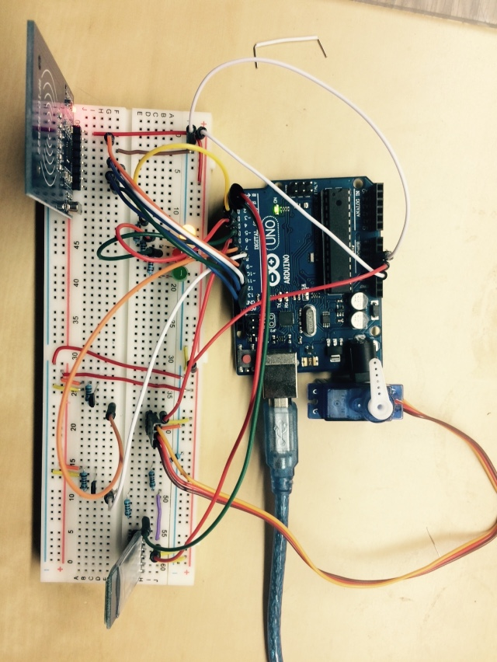
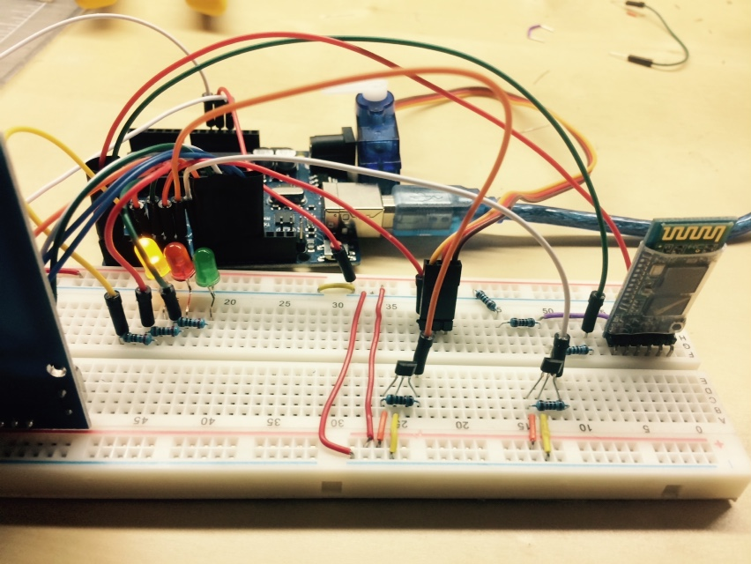
Controls and Sensors
Currently, electrical controls are programmed to:
RFID tag is read.
Solenoid plunger actuates.
Hall Effect sensors read position of door
Status LEDs display door and lock position

Slide 7
WiFi and Bluetooth Communication
Mobile WiFi and Bluetooth communication
enables the user to:
Lock/ Unlock door.
View position status of door.
View which dog went through door
Set up to receive dog activity data.

Slide 8
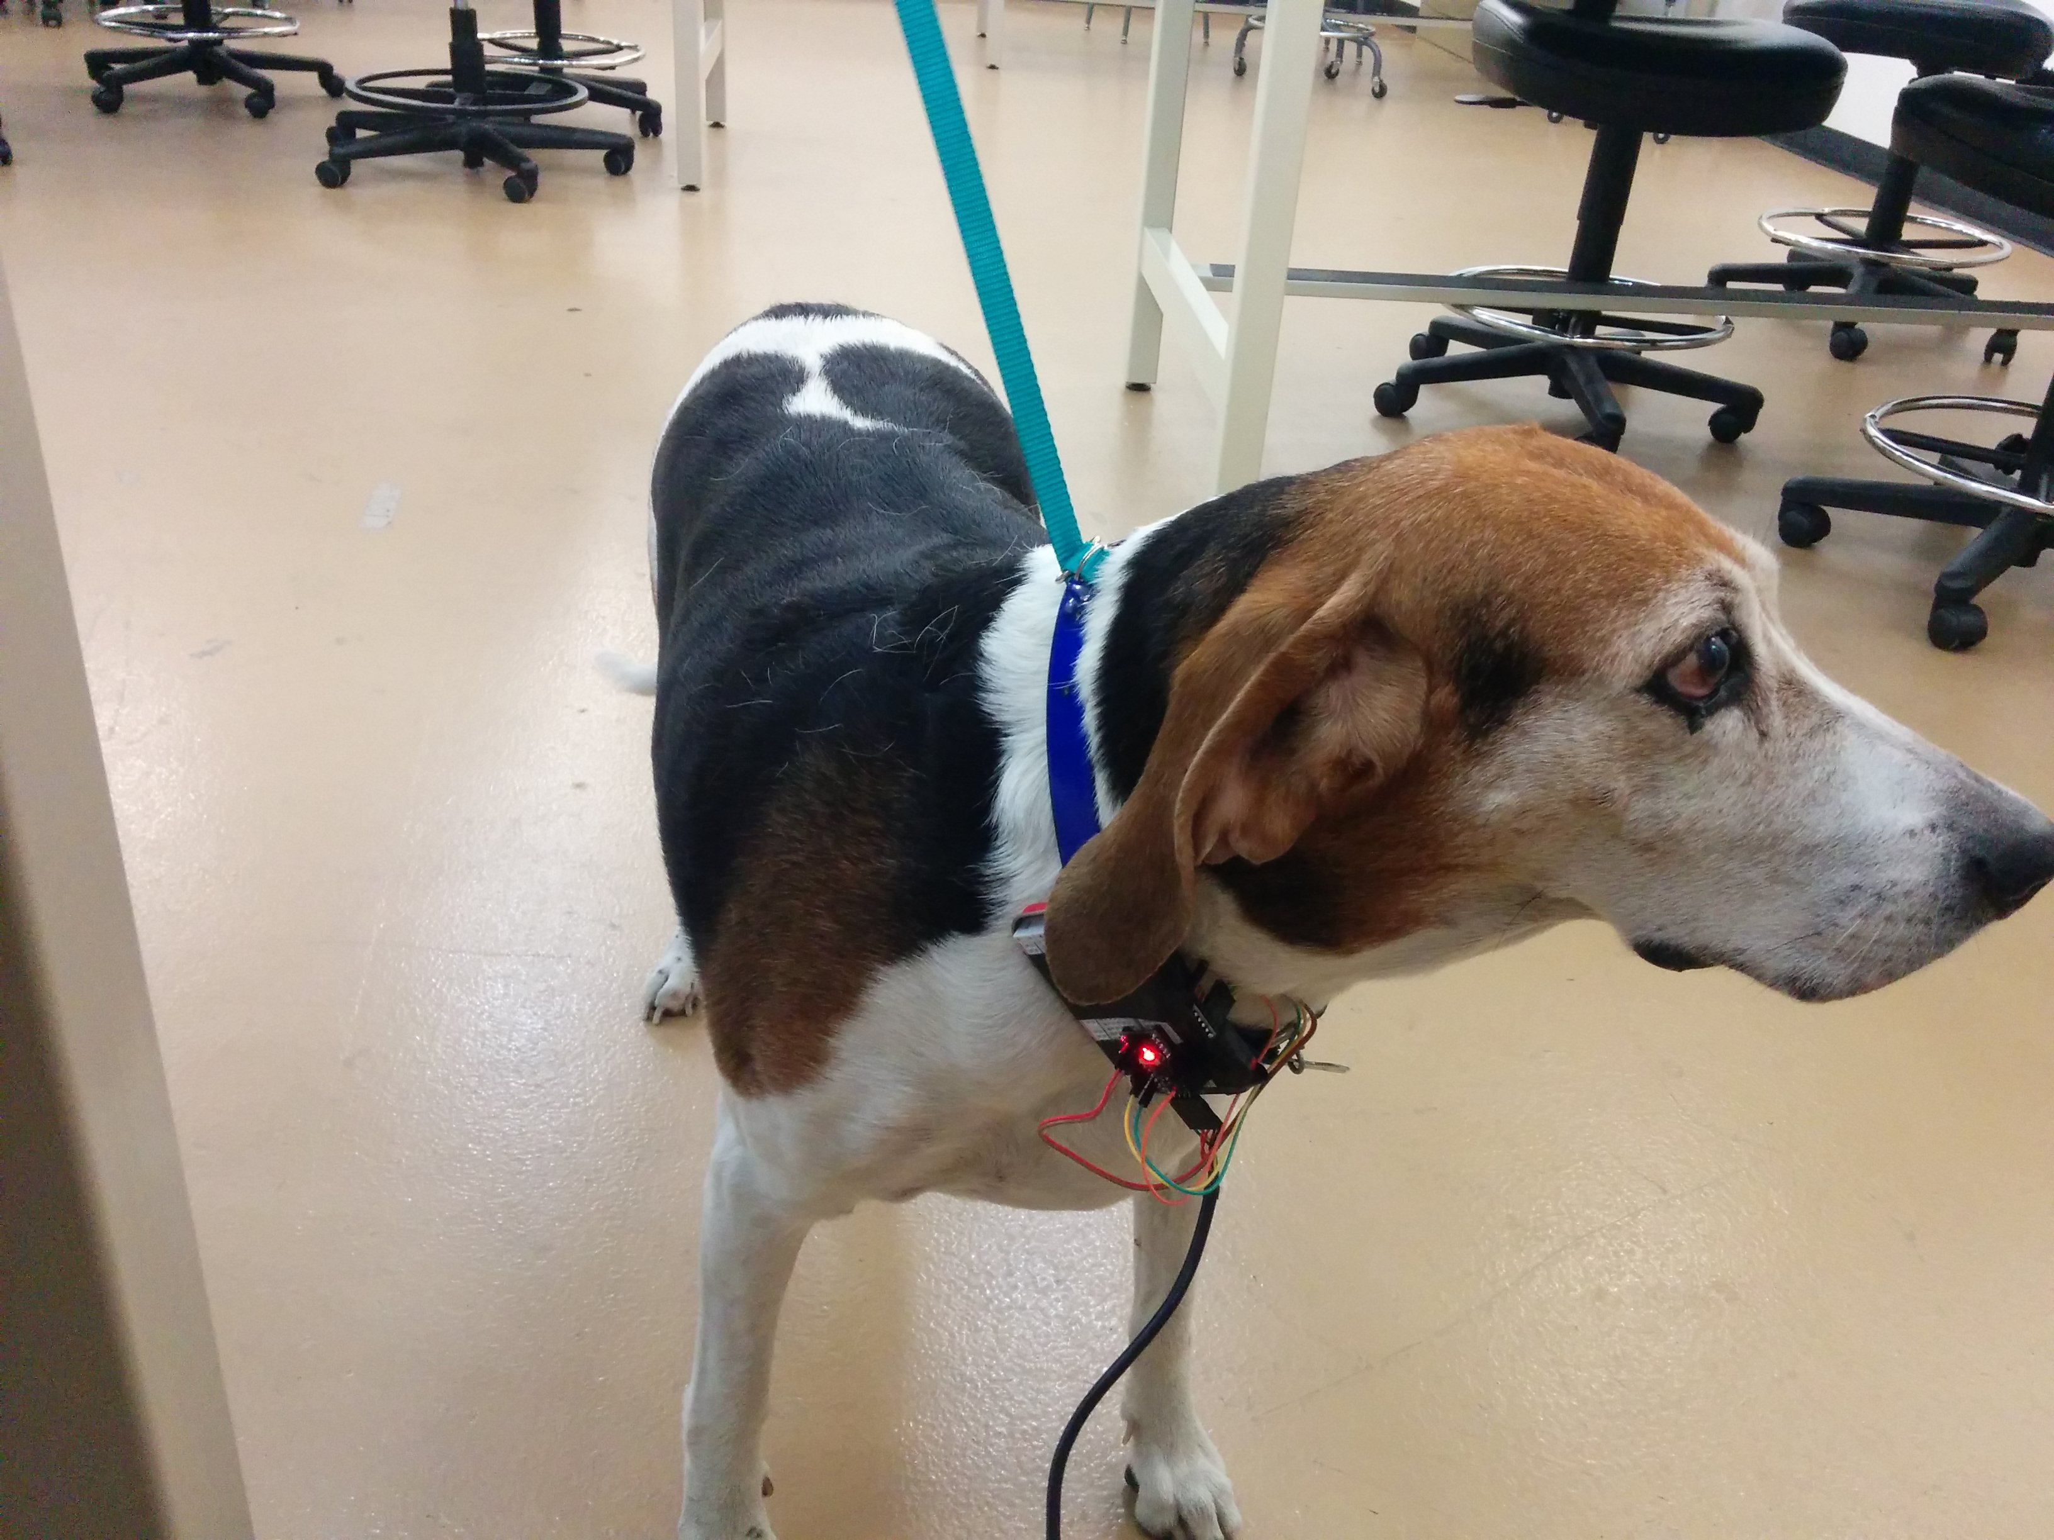
Step Detection
Using a gyroscope and accelerometer, the dog’s steps are tracking with moving thresholds

Slide 9
Transmission of Step Info
The module on the dog will communicate over Bluetooth to the door, which will in turn allow the user to view the data on a mobile device

Slide 10
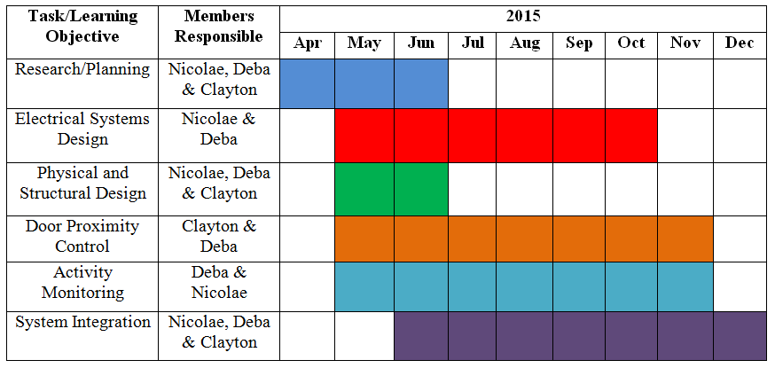
Conclusion
The project will be divided in seven different phases in order complete the project within the given time.
1. Research/Planning
2. Electrical Systems Design
3. Activity Monitoring
4. Bluetooth Door Control
5. Systems Integration
6. Testing
7. Final Report/Documentation

